Slide 1
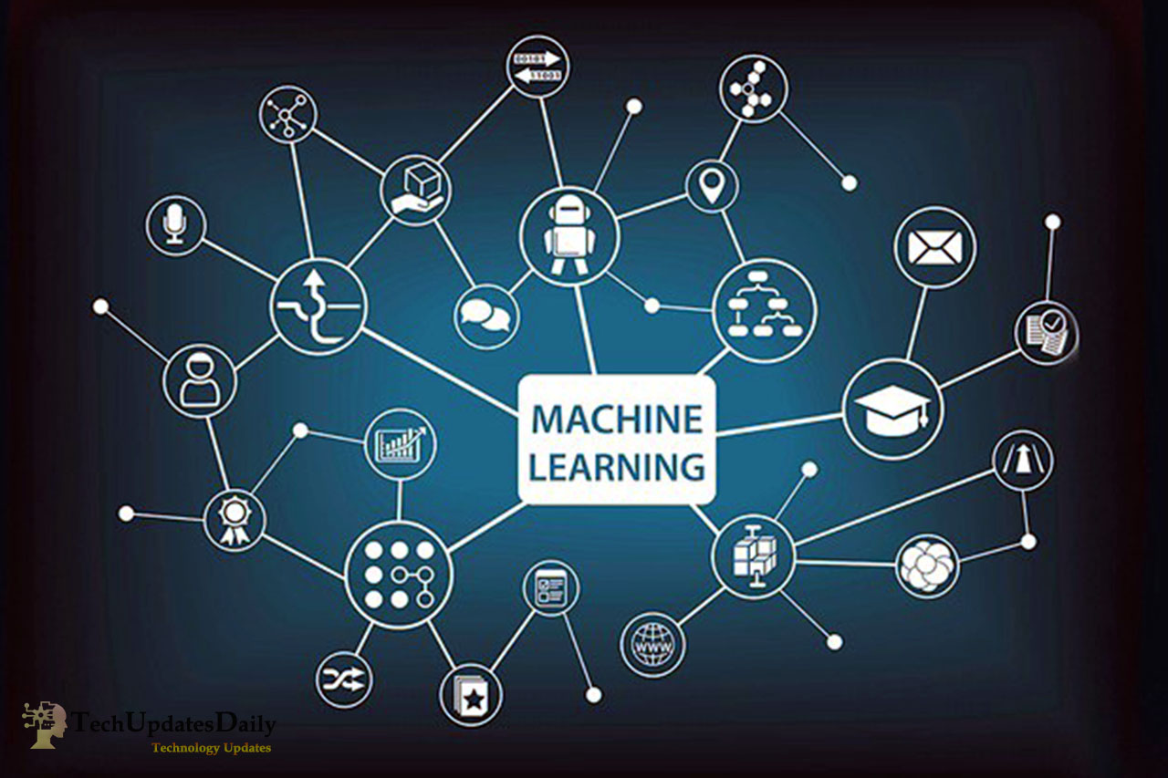
Predicting Customer Purchase Behavior
Machine Learning
Name: Samarth Pansala
Date: 5th September, 2024

Slide 2
Objective
Develop a machine learning model to predict whether a customer will make a purchase.
Use customer demographic and behavioral features to improve business decision-making.

Slide 3
Problem Statement
Given a dataset with variables such as age, gender, annual income, number of purchases, and more, predict the likelihood of purchase.
Variables:
Age, Gender, Annual Income, Number of Purchases, Product Category, Time Spent on Website, Loyalty Program, Discounts Availed.

Slide 4
Data Preprocessing
1) Handling Missing Data: Impute missing values for numerical and categorical variables.
2) Feature Encoding: Encode categorical variables like Gender and Product Category.
3) Feature Scaling: Apply Standardization using z-scores to ensure all features are on the same scale.

Slide 5
Feature Scaling Overview
Feature scaling ensures that features with larger ranges don’t dominate the model.
Logistic Regression is sensitive to the scale of features, making standardization important.
Formula: z = (x−μ)/σ
μ = mean
σ = standard deviation

Slide 6
Exploratory Data Analysis (EDA)
Age Distribution: Most customers fall within the 25-45 age range.
Gender: Balanced dataset with both male and female customers.
Time Spent on Website: Higher time spent correlates with higher purchase probability.
Loyalty Program: Loyalty members are more likely to make a purchase.

Slide 7
Logistic Regression Overview
Logistic Regression is a binary classification algorithm used to predict outcomes.
Sigmoid Function: Converts raw output to probability values. P(y=1∣X)=1/e^-z
Where z=β0+β1X1+⋯+βnXn
Predicts the likelihood of purchase (1 = Purchase, 0 = No Purchase).

Slide 8
Model Training
Train-Test Split: Split data into 80% training and 20% testing.
Model Training: Trained Logistic Regression on scaled data.
Model Coefficients: Coefficients show the impact of each feature on the likelihood of purchase.

Slide 9
Model Evaluation
Accuracy: Measure of correctly predicted instances.
Precision: Proportion of true positive predictions.
Recall: Ability of the model to detect actual positives.
F1-Score: Harmonic mean of precision and recall.
Confusion Matrix: Show performance in terms of True Positives, False Negatives, etc

Slide 10
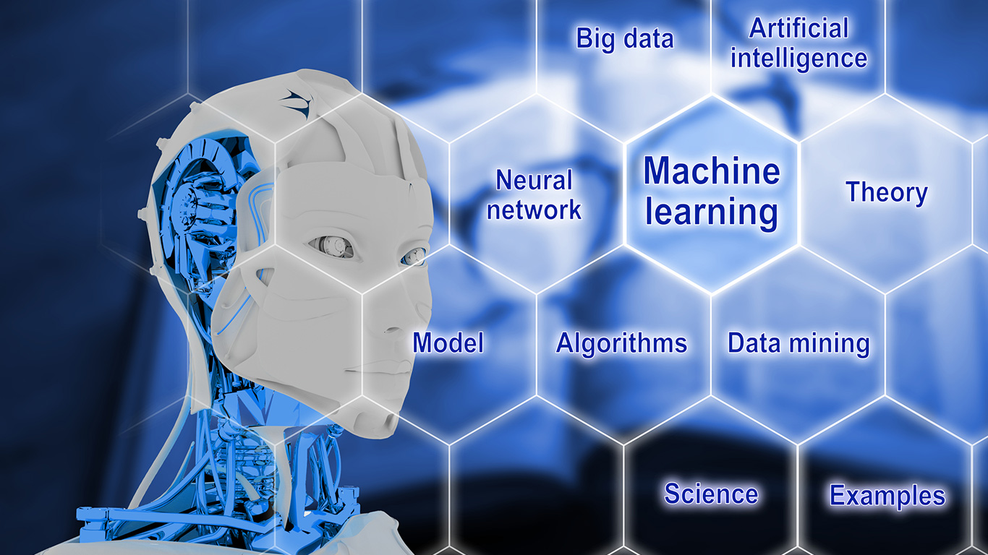
Conclusion and Future Work
Logistic Regression provides clear insights into customer behavior.
The model can help businesses tailor marketing strategies to increase conversion rates.
Next Steps: Further tuning and exploring more complex models for higher accuracy.

Slide 11

Thank You

